Slide 1
Optimizing Market Vendor Inventory in Uganda Using Reinforcement Learning
Theresa Nabyonga
21.November.2025
MSDS-Data Science Lifecycle

Slide 2
Introduction
Market vendors in Uganda face significant challenges in managing their inventory leading to stockouts, overstocking and reduced profits.
Currently, most vendors rely on intuition and manual tracking resulting in inefficiencies.
The goal is to develop a Reinforcement Learning-based system to optimize inventory control and improve vendor earnings.

Slide 3
Problem Statement
Market vendors in Uganda face difficulties managing inventory leading to:
Stockouts → customer dissatisfaction &lost sales
Overstocking → spoilage/waste & reduced profits.
Manual or intuition based inventory is sub-optimal.
Dynamic demand (changes with day of week, season, or events).
Reinforcement Learning (RL) allows the vendor to:
Learn from past sales
Adjust order quantities dynamically
Maximize daily profit while minimizing stockouts

Slide 4
Objective
Design and train an RL agent to:-
Suggest the optimal number of units to order daily.
Reduce stockouts and overstock
Increase profitability for market vendors

Slide 5
MDP Formulation
Markov Decision Process (MDP) definition:
State (S): (current stock, day of week, moving average demand)
Action (A): Number of units to order (0 → max order, e.g., 20 units)
Reward (R): Profit = revenue - holding cost - stockout penalty
Transition (P): Daily demand is stochastic; next state depends on current state & action

Slide 6
RL Algorithm choice
Algorithm: Q-learning (tabular)
Why Q-learning:-Simple & interpretable for discrete state-action space
-No need for deep networks for small inventory problem
Key concepts:
-Exploration vs. Exploitation: epsilon-greedy strategy
-Q-table: stores expected rewards for each (state, action) pair

Slide 7
Environment & Training
Environment: MarketEnv simulates vendor shop: daily demand & inventory
Training parameters:
-Episodes: 3000
-Days per episode: 30
-Learning rate (alpha): 0.1
-Discount factor (gamma): 0.99
-Epsilon decay: 0.995
Metrics tracked:
-Average daily profit
-Profit standard deviation
-Total stockouts

Slide 8
Training Results
Performance
-Average daily profit: 4241.75
-Profit std: 300.49
-Total stockouts: 7851 units over 3000 episodes
Observations:
-Agent learns to balance supply and demand
-Avoids over-ordering while minimizing stockouts
-Epsilon decay ensures shift from exploration to exploitation

Slide 9
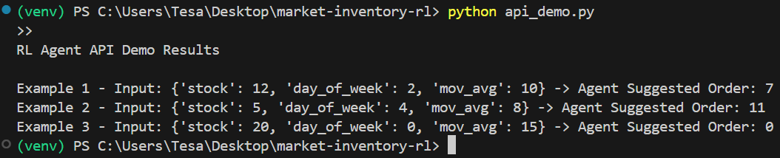
API Demo
The Purpose is to demonstrate RL agent predictions via API.
import requests
examples = [
{"stock": 12, "day_of_week": 2, "mov_avg": 10},
{"stock": 5, "day_of_week": 4, "mov_avg": 8},
{"stock": 20, "day_of_week": 0, "mov_avg": 15}
]

Slide 10
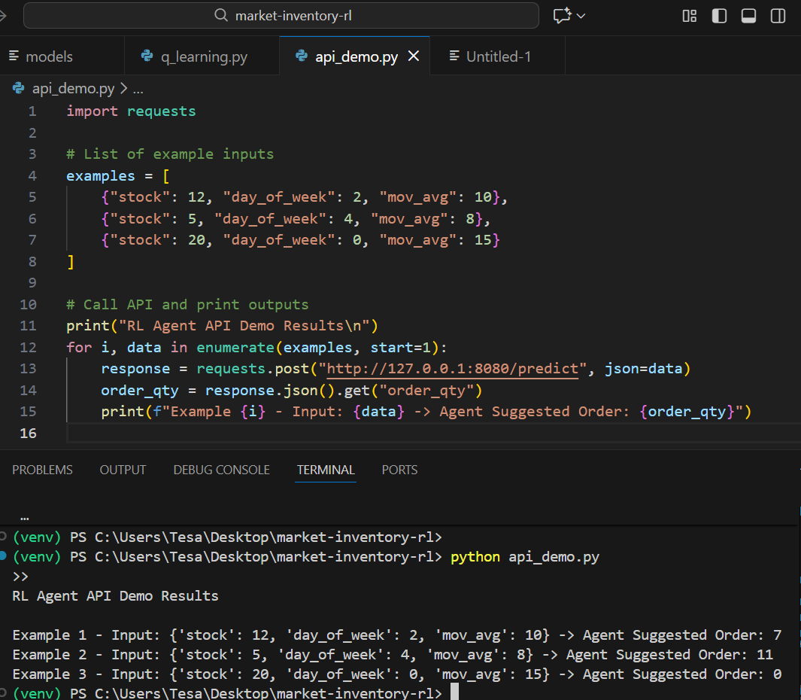

Slide 11
Deployment
Model serving: FastAPI
Containerization: Docker ready
Deployment options:
-Local server
-Cloud (AWS SageMaker, Azure ML, GCP Vertex AI)
Monitoring:
-Track reward, stockouts, performance
-Detect data drift or policy degradation

Slide 12
Conclusion
RL agent successfully learns optimal ordering strategy
-Reduces stockouts
-Increases profit
Flexible and scalable for real-world use
Future improvements:
-Multiple products
-Seasonal demand patterns
-Integration with live sales data

Slide 13
References
OpenAI Gym documentation
FastAPI documentation
Python libraries: numpy, pandas, matplotlib
Reinforcement Learning textbooks and tutorials

